Slide 1
Clemson Softball 2025
Mason Castellan

Slide 2
Agenda
Roster Overview
Season Development
Offense
Pitching
Leadership
Next Season

Slide 3
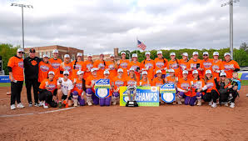
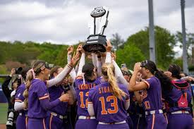
Unranked to #11
Clemson was the 30th best team in the country according to USA Softball voters (Preseason Poll).
https://www.ncaa.com/news/softball/article/2025-01-21/texas-tops-2025-preseason-espncom/usa-softball-poll
As we know, they ended up hosting Regionals and making it to Super Regionals, after winning the ACC Championship.

Slide 4
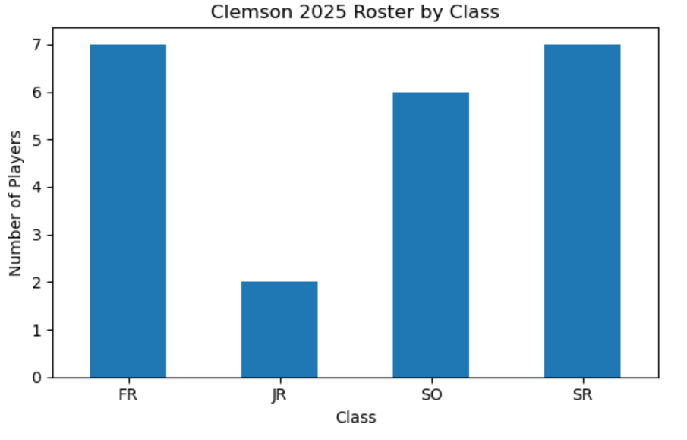
Roster Overview
7 Freshmen
6 Sophomores
2 Juniors
7 Seniors
Does not follow most collegiate sports in NIL-era
Senior impact, but underclassmen core

Slide 5
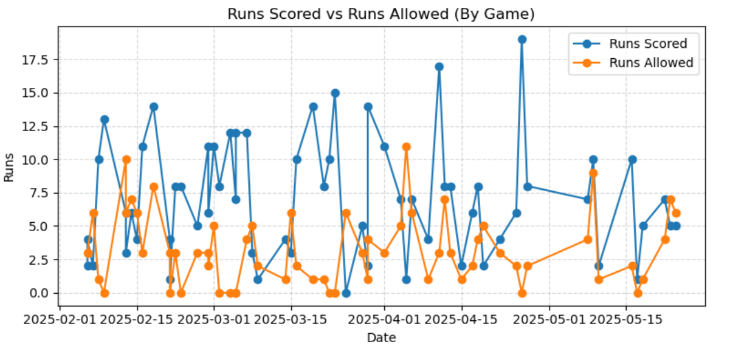
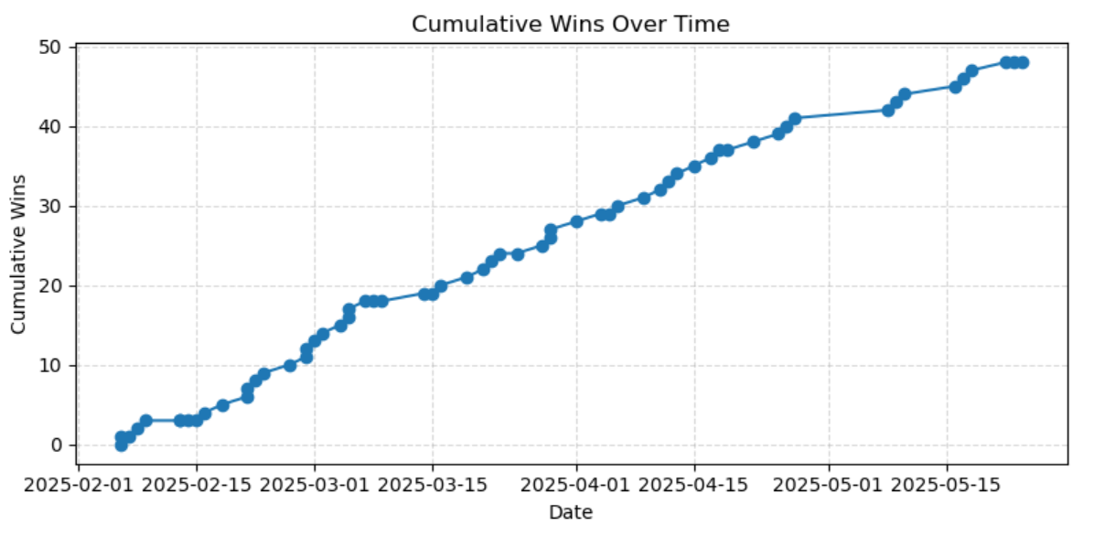
Season Development
Early season slump: 3–6 start through mid-February
Dramatic turnaround begins Feb 16
15-game winning streak carries team into March
Steady climb afterward, finished with 48 wins

Slide 6
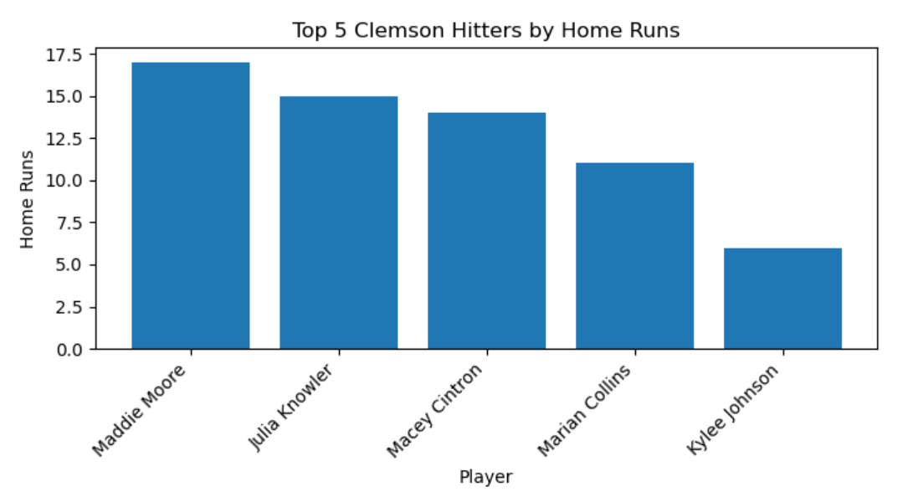
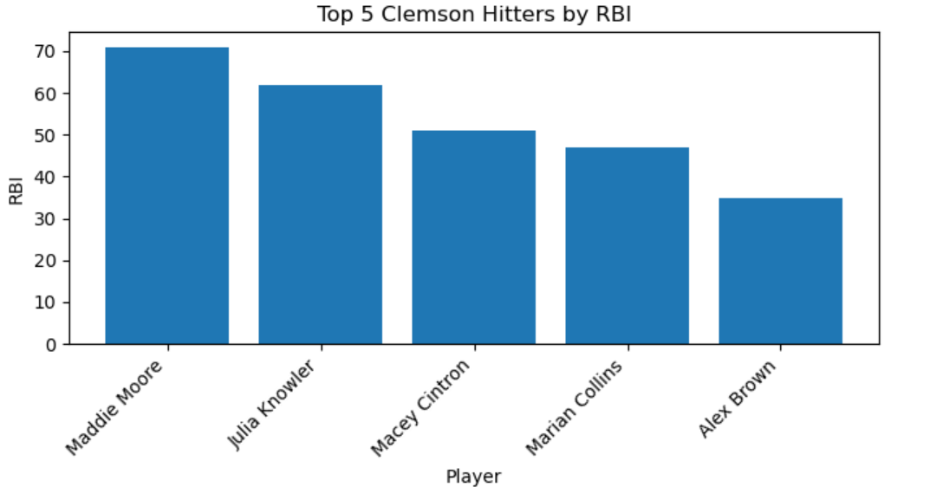
Offense
Offense averaged 7.1 runs per game, consistently outscoring opponents.
Maddie Moore drove the engine: 71 RBI, 17 HR — centerpiece of production.
Julia Knowler and Macey Cintron added premium power (15 & 14 HR).
Marian Collins rounded out the middle with 47 RBI and 11 HR.
Alex Brown led in runs scored and still cracked top-5 RBI → elite table-setter.
Four players with double-digit home runs show a deep, dangerous lineup.
Game-by-game scoring shows Clemson repeatedly putting up big innings, overpowering opponents.

Slide 7
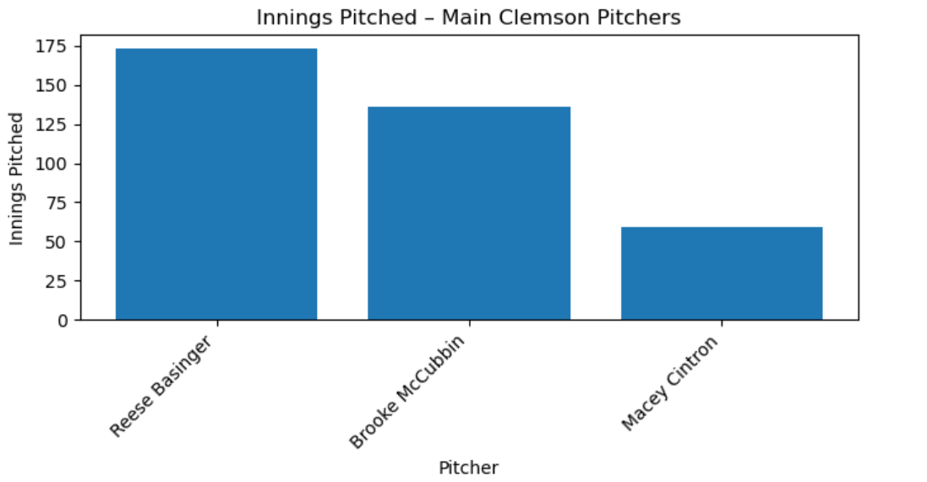
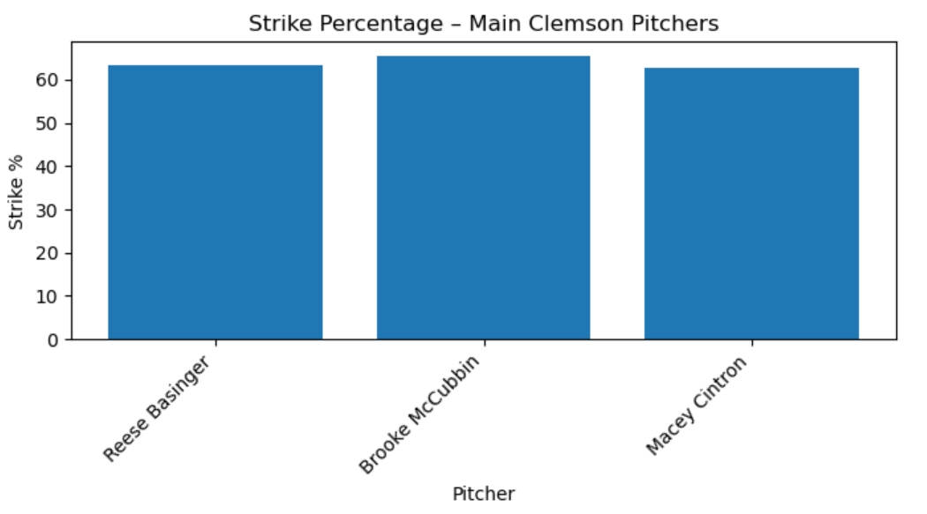
Pitching
Staff anchored by senior arms:
  Reese Basinger: 174 IP (true ace workload)
  Brooke McCubbin: 136 IP (steady #2 starter)
Macey Cintron offered strong freshman contributions (~60 IP).
High strike percentages across staff (63–65%) attack-the-zone pitching philosophy.
Command limited walks, forced hitters to earn everything, and complemented the high-scoring offense.
Pitching and offense meshed: Clemson scored often and pitchers avoided self-inflicted damage.

Slide 8
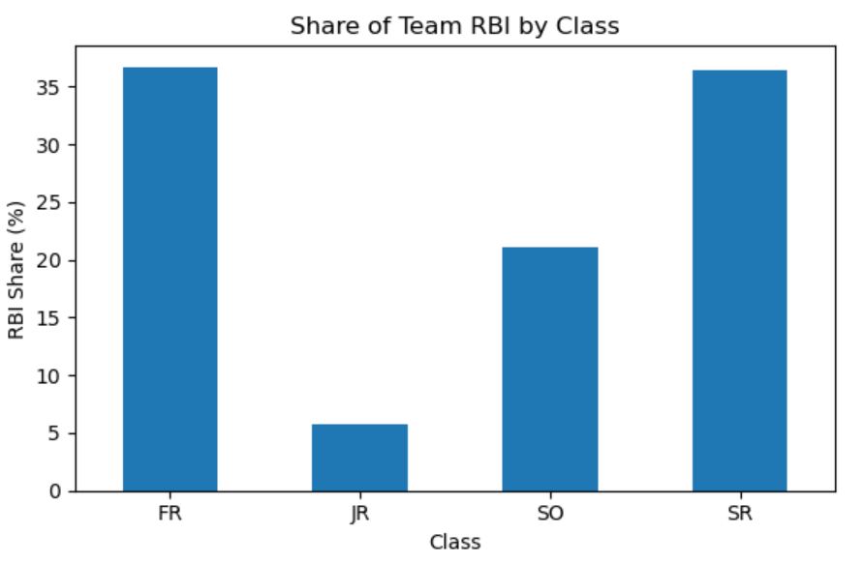
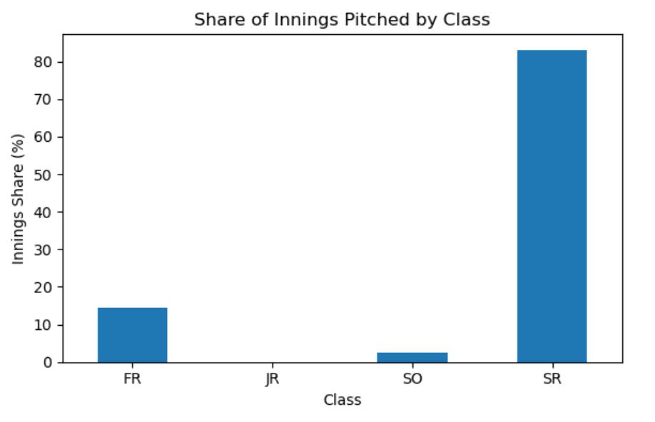
Leadership
Seniors produced the largest share of RBI, leading the scoring.
Underclassmen (FR/SO) still provided a meaningful portion of total RBI.
Offense was led by veterans but supported by a strong young core.
Senior pitchers handled the majority of innings, showing who carried the staff.
Younger pitchers (FR/SO) already have real game experience, not just mop-up work.
Workload distribution highlights veteran leadership on the mound with a clear pipeline behind them.

Slide 9
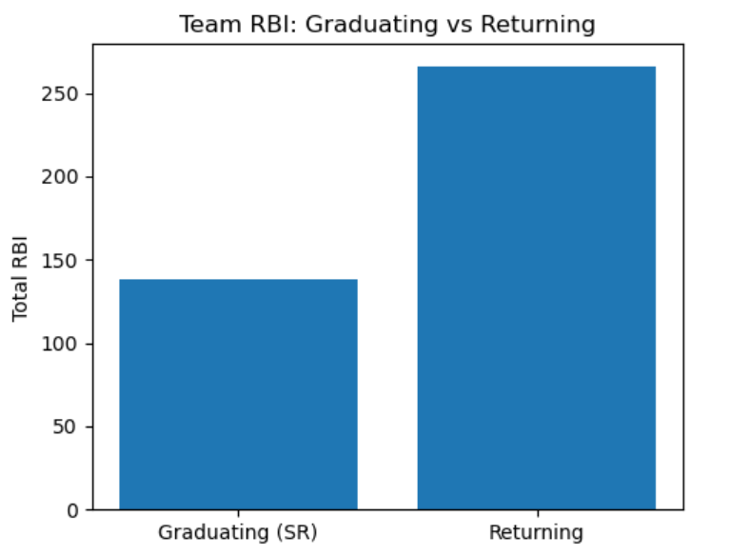
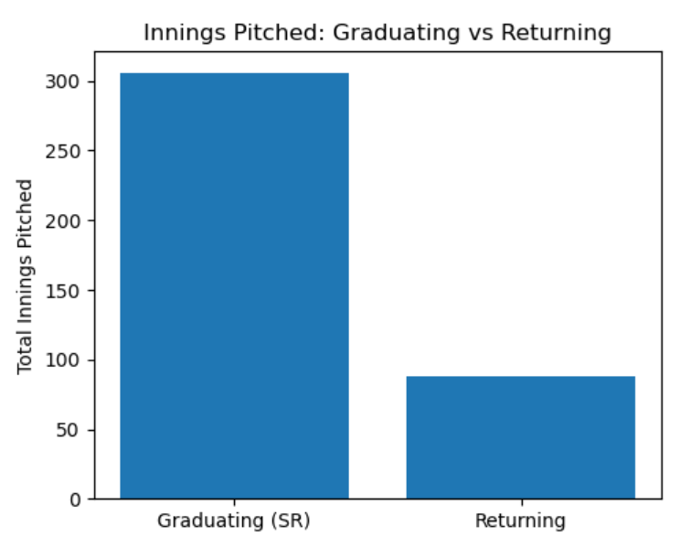
Next Season: Going Forward
Seniors account for a huge chunk of total RBI and innings pitched.
Offensively, you lose the production of Moore/Brown and other SR bats.
On the mound, most of the high-volume innings were thrown by SR arms.
However, returning players still bring substantial RBI and innings, so this is a retool, not a total reset.

Slide 10
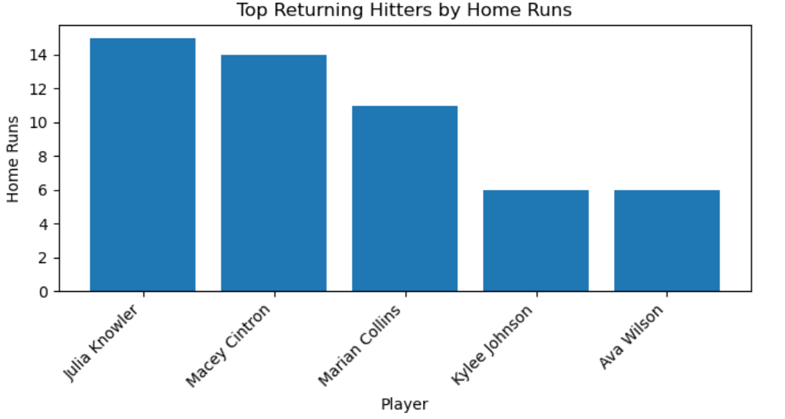
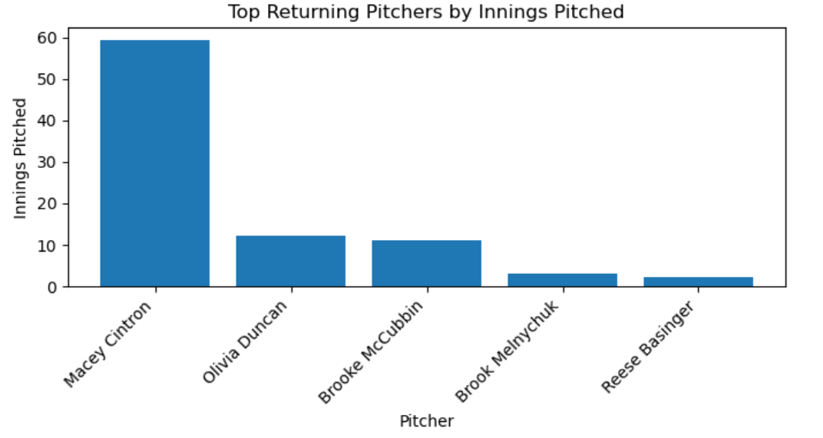
Next Season: Going Forward
Even after graduation, Clemson returns real power: Knowler, Cintron, Collins and others with double-digit HR potential
Returning hitters already have proven RBI and HR totals, not just small-sample flashes
On the mound, underclass pitchers bring back meaningful innings, giving a base rotation to build around
These charts show why 2025 is a launchpad year: key seniors leave, but the statistical core of the next wave is already established
Clemson currently has the 15th ranked incoming recruiting class (https://www.on3.com/rivals/rankings/team/softball/2026/)

